Slide 1


Slide 2

Empowering Public Health
Remember Your Why

Slide 3

Powerful Presence
Servant Leadership
Self Care
Remember Your Why

Slide 4

Powerful Presence

Slide 5


Slide 6


Slide 7


Slide 8


Slide 9


Slide 10

Servant Leadership

Slide 11


Slide 12


Slide 13


Slide 14

Self Care

Slide 15
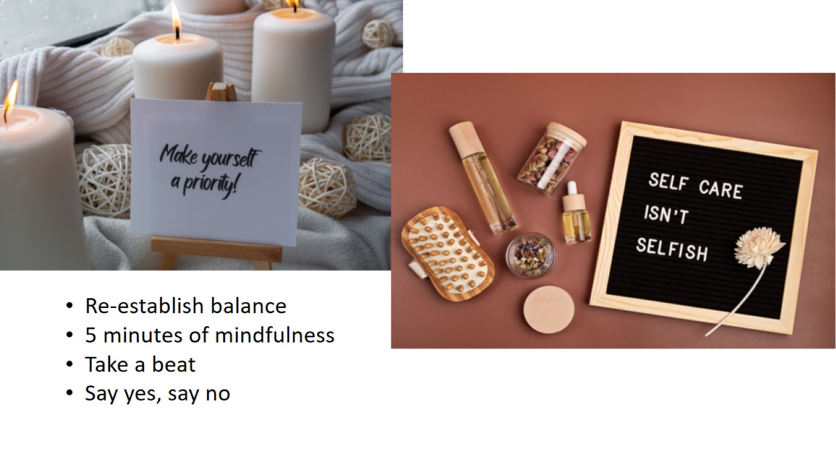

Slide 16


Slide 17

Remember Your Why

Slide 18


Slide 19


Slide 20
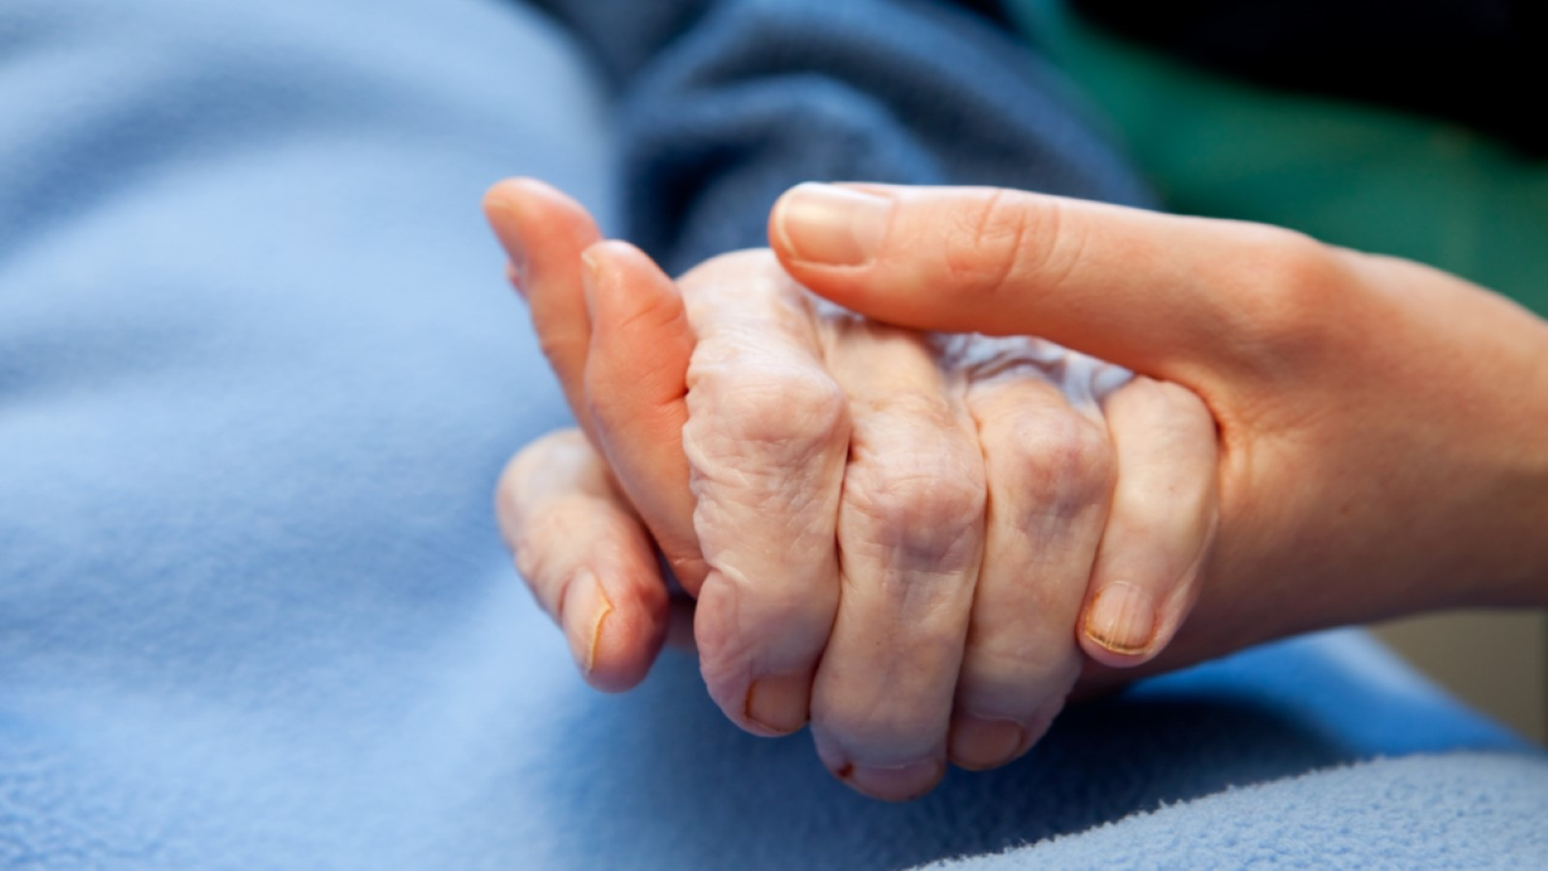

Slide 21
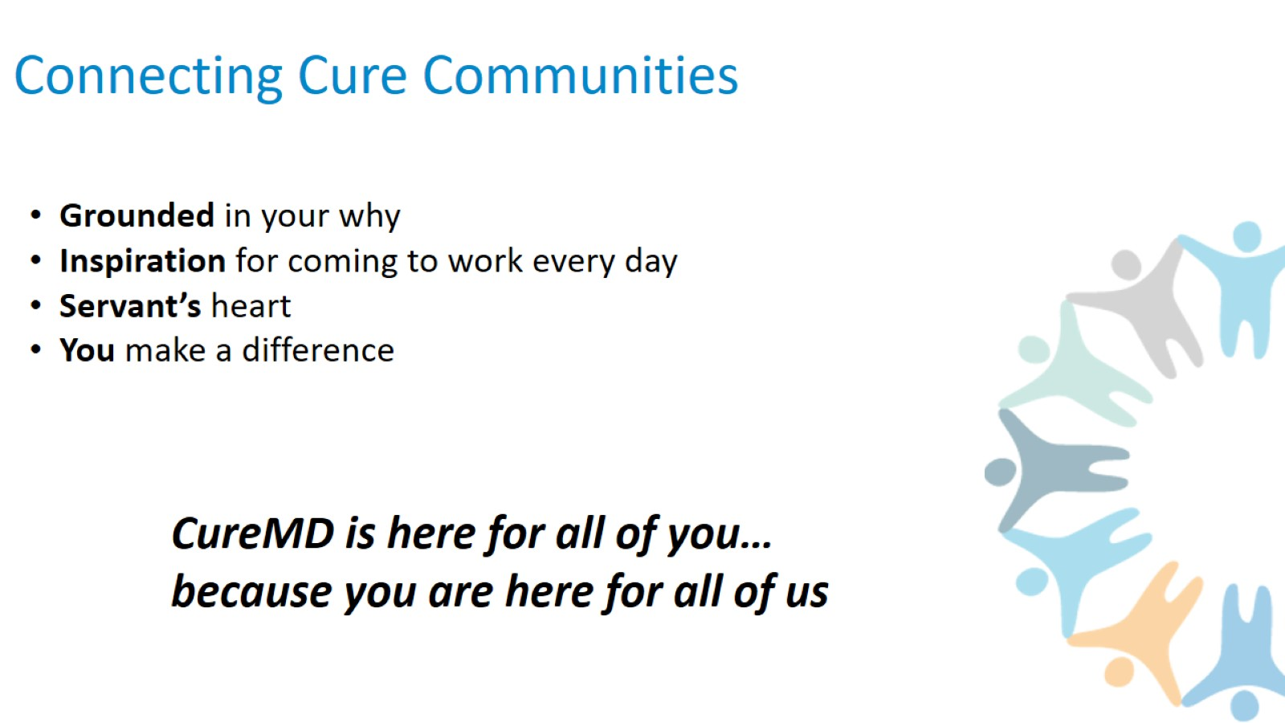
Connecting Cure Communities

Slide 22
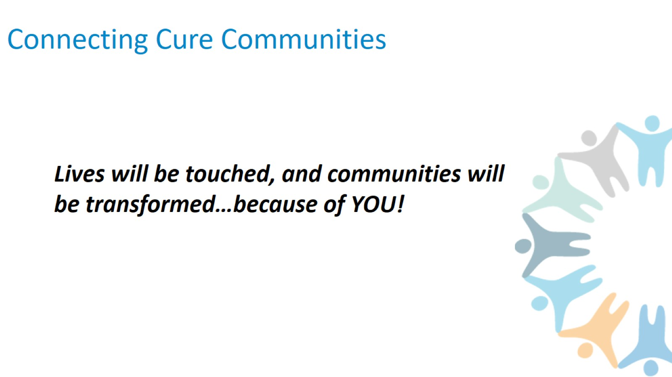
Connecting Cure Communities

Slide 23


Slide 24


Slide 25

Thank you.

